Slide 1
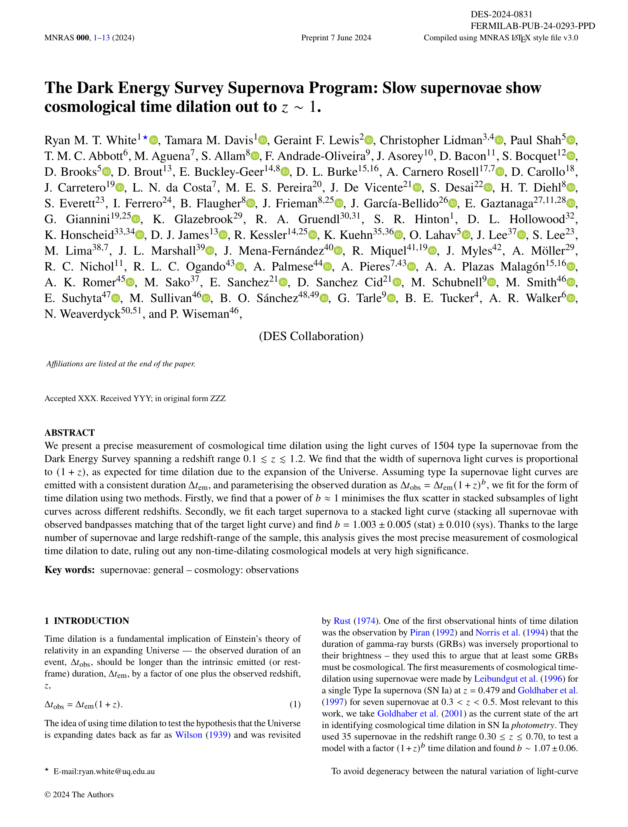
Exploding stars show us that time slows down in the distant Universe!
This work is the combined effort of a *lot*
of very smart people…
So many people from so many places that we had to put the places at the end of the paper!
Here’s the tl;dr…
For almost 100 years we’ve known that the Universe is expanding. Our models of an expanding Universe predict that a very far away clock will tick slower than one right next to us – something called cosmological time dilation. In this paper we treat exploding stars like clocks, using more of these and at higher distances than ever before to measure time dilation. Using the most data-driven approach so far, we find… pretty much what we expected! With the quality of the data from our collaboration, the Dark Energy Survey, this is the most precise detection of cosmological time dilation so far.
Here’s the background:
What we’re looking for in the paper isn’t a new idea; using exploding stars, supernovae, as clocks was proposed 85 years ago! Lots of people have used these and other transient light sources to quantify time dilation before…
Cosmological time dilation is yet *another* prediction that can be traced back to Einstein!

Slide 2
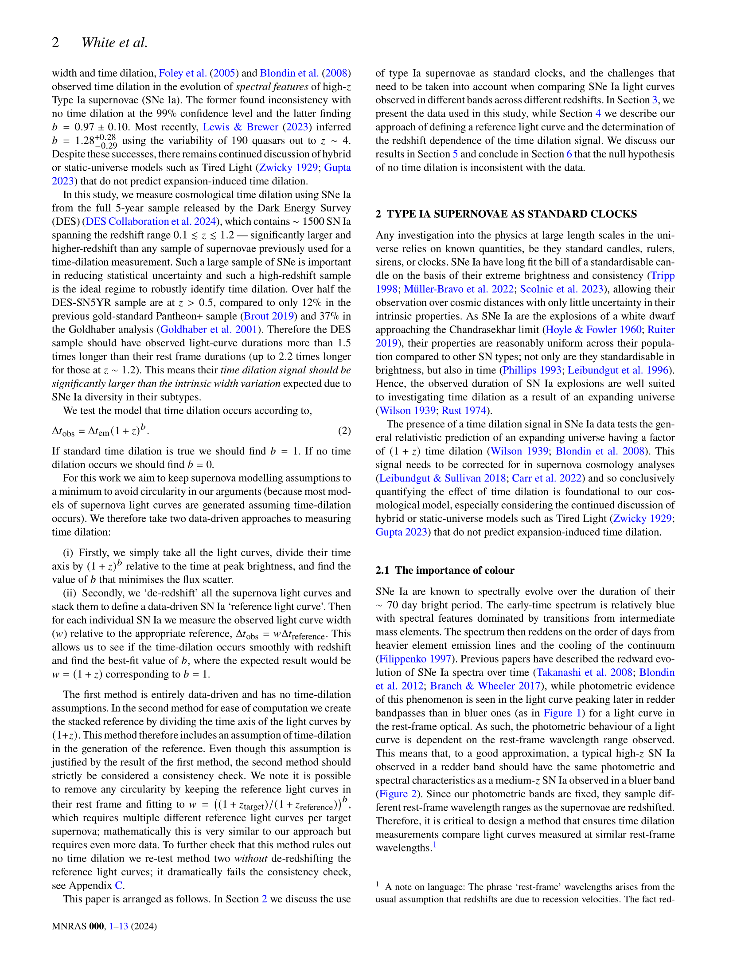






































… seriously, this is something that lots of smart people have looked at before!
It’s important to use the most distant supernovae possible for these types of studies. The further away a supernova is, the stronger the time dilation signal! This lets us find the signal amongst the noise.
We want to be really sure about how much time dilation there is as we correct for this in cosmological analyses.
To detect time dilation we can compare how different supernovae change over time.
Type Ia supernovae are the result of ‘white dwarf’ stars exploding. These white dwarf stars are the super-compact remnant cores of stars that have shed their outer layers – kind of like the skeleton left over after we die. Some of these stars steal extra material from nearby stars while in their white dwarf phase. When they steal so much matter that they reach a critical mass (the Chandrasekhar mass) they explode! Since they all explode at this same mass, Type Ia supernovae all look pretty much the same no matter where they are!
Type Ia supernovae get
redder over time,
which means that we need to be
careful when
we compare them…
Day 0
Day 20
Day 60

Slide 3
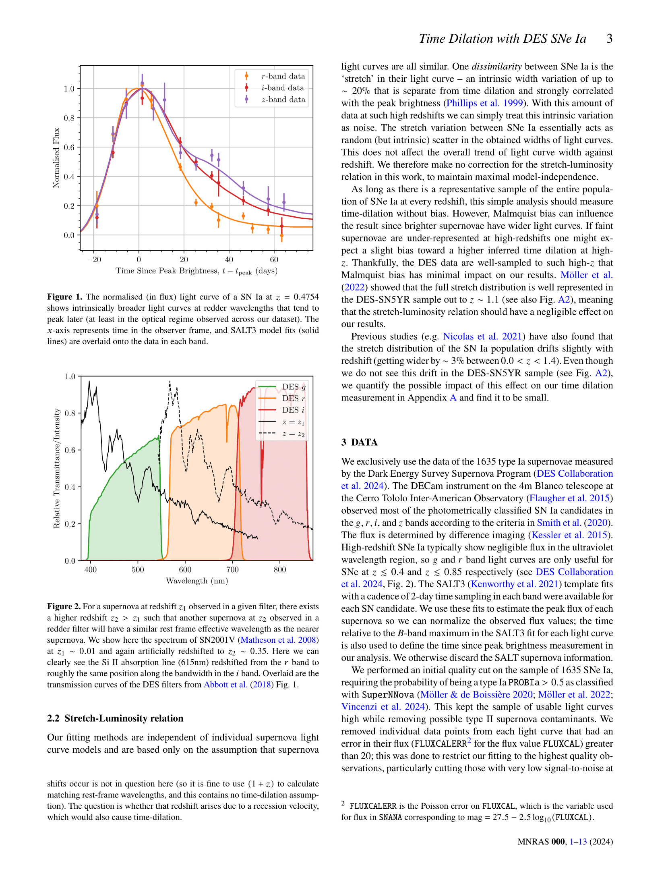
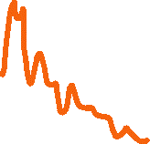





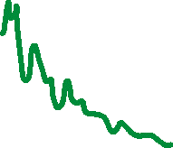
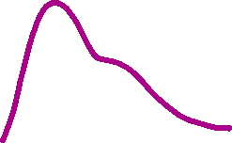



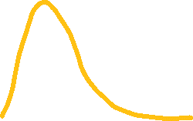

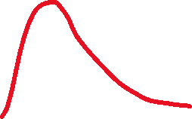
Type Ia supernovae aren’t actually as consistent as I’ve been letting on, but they do average out nicely! Some supernovae are intrinsically brighter than others and so they have ‘wider’ light curves, meaning they effectively take longer to explode. On the plot to the left, one of these special supernovae would be a bit taller and a bit wider!
This actually has the same effect as time dilation and this makes our analysis a bit trickier. Luckily the Dark Energy Survey found so many supernovae of all types that we don’t need to correct for this; it all averages out. Even if it didn’t average out, this would affect is not as strong as the time dilation.
Orange-ish
Red
Infrared
How bright the supernova is
Days since the explosion
This is what our data looks
like! We have ‘light curves’
of 1504 unique supernovae,
in multiple colours
Far away
supernova
What data do we have?
Close supernova
Brightness of light we see
Galaxy during supernova
Galaxy before or after supernova
Just the supernova!
Bluer
Redder
Colour of light we see
The 4m Blanco Telescope
at the Cerro Tololo Inter-American Observatory observed thousands of supernovae for the Dark Energy Survey. 1504
of them made the
cut for this paper!
The expanding Universe makes distant blue light appear red to us – we call this ‘redshift’. This plot shows that the colour spectrum of a supernova that’s far away is redshifted compared to one that’s close by

Slide 4
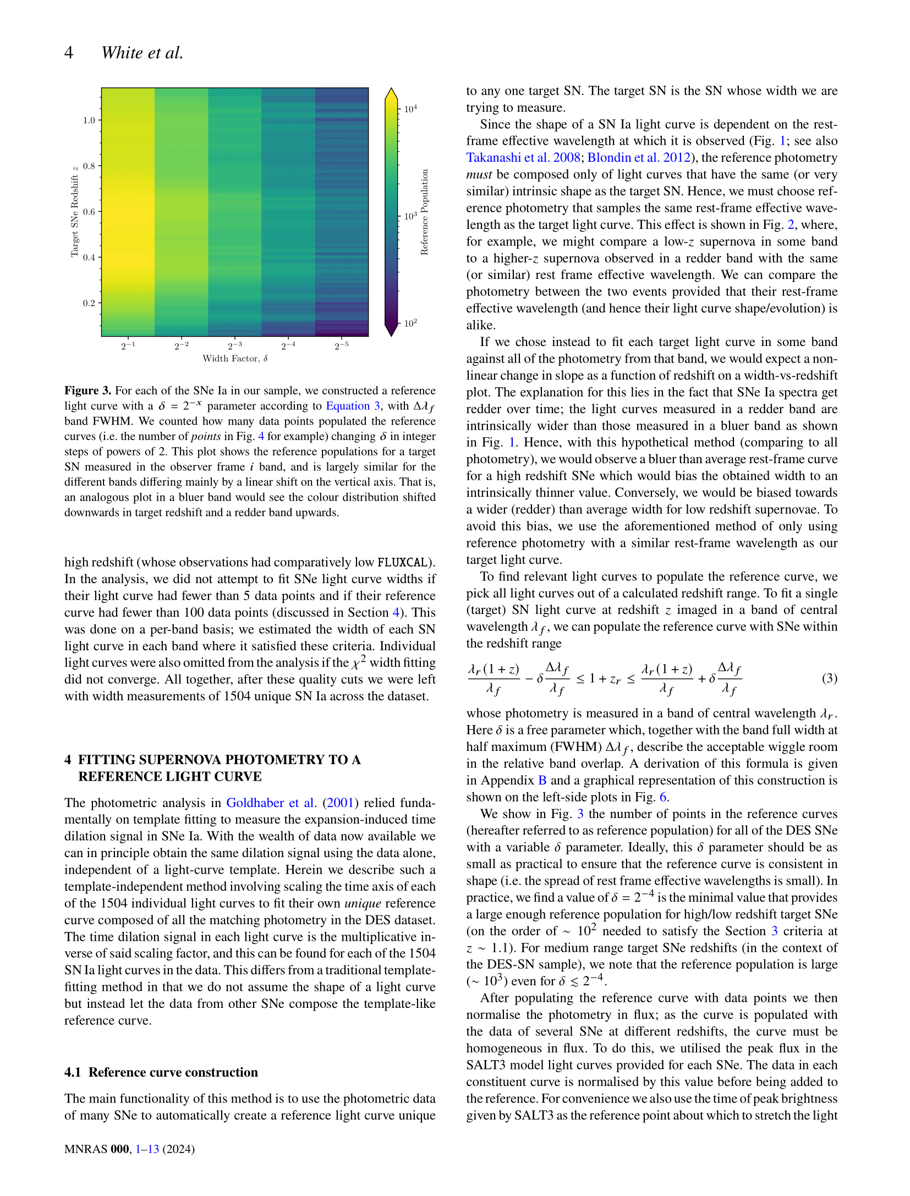

So we know that supernovae appear differently depending on the colour we look at them with. We also know that redshift means that when we look at red light from a far away supernova, we’re actually looking at intrinsically blue light that’s been shifted to the red as the light has travelled to us.
If we want to compare supernova light curves across different redshifts, we need to account for these effects. We proposed using a mathematical selection function*
to carefully choose light curves at certain redshifts and in certain colours so that we get a sample that should all have the same shape.
What do *we* do in the paper?
This equation essentially says that if we want to compare with a supernova at a very high redshift, we need to collect light in a redder filter so that we’re seeing the same type of stuff!
Since we have a finite amount of data, we can’t choose light curves that’ll have exactly the same shape, but the sheer number of supernovae with DES means that we can pick lots of light curves that are pretty close!
If time dilation is real, we should see that supernovae take longer at higher redshift (from our perspective). That means that if we literally stack light curves from various redshifts that should have the same shape, the higher redshift ones will appear wider!
Our method is unique in that we use *only* the data from the Dark Energy Survey – no other supernovae were hurt in the making of this paper.
*For astrophysics, we’re kind of light on the math in this paper!

Slide 5
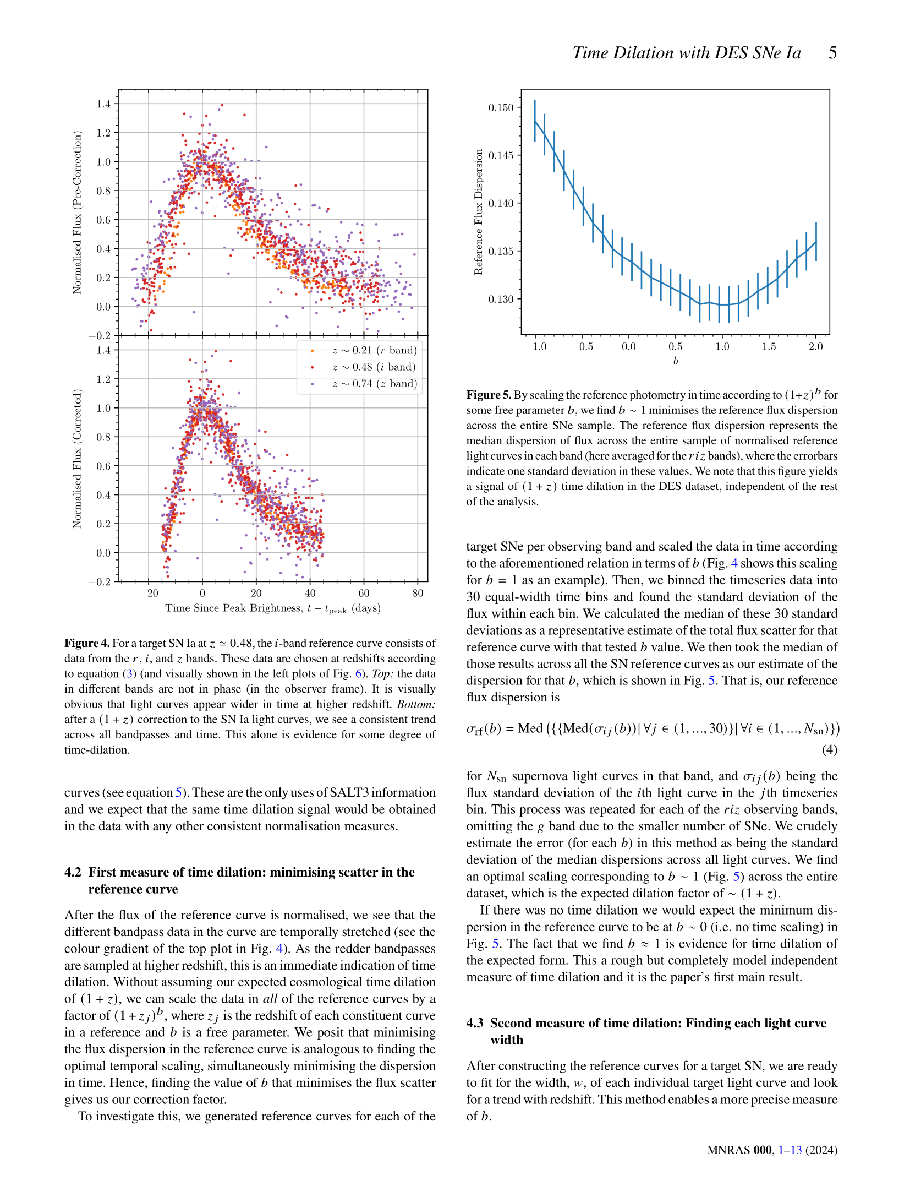
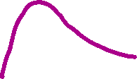
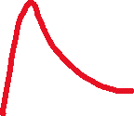
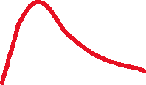
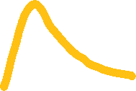
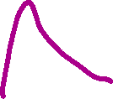
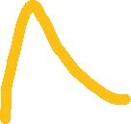

This is what it looks like when we stack them…
No time dilation
The error in matching up the colours
Time dilation we expect
How bright the supernova is
And this is what it looks like when we measure and correct for time dilation
How much time dilation there is
(lower values of error is better!)
What we did on the left column was just for one individual ‘center’ redshift value (in that case, trying to match the shape of a red light curve at redshift 0.5). We can do this for all of the 1504 DES center redshifts and find the time dilation value that best matches up all of the colours.
We fit a factor of time dilation of (1+z)^{b}, where z is the redshift value and b is just some number; b=0 means no time dilation and b=1 is the time dilation we expect in our expanding universe. The plot at the top of this column shows that when we fit for all of the light curves, we find b=1 matches up best. Cosmology can rest easy! For now…
Days since the explosion
When we take orange light from redshift 0.2 supernovae, red light from redshift 0.5 supernovae, and infrared light from redshift 0.75 supernovae, all of these light curves should look the same! But the top plot shows that the redder light curves (from higher redshifts!) are *wider*. This is time dilation in action!
This part of the paper describes one way that we can measure time dilation. If we squish the light curves along the time axis by a certain amount so that all of the different colours line up, we’ve got our time dilation measurement!

Slide 6
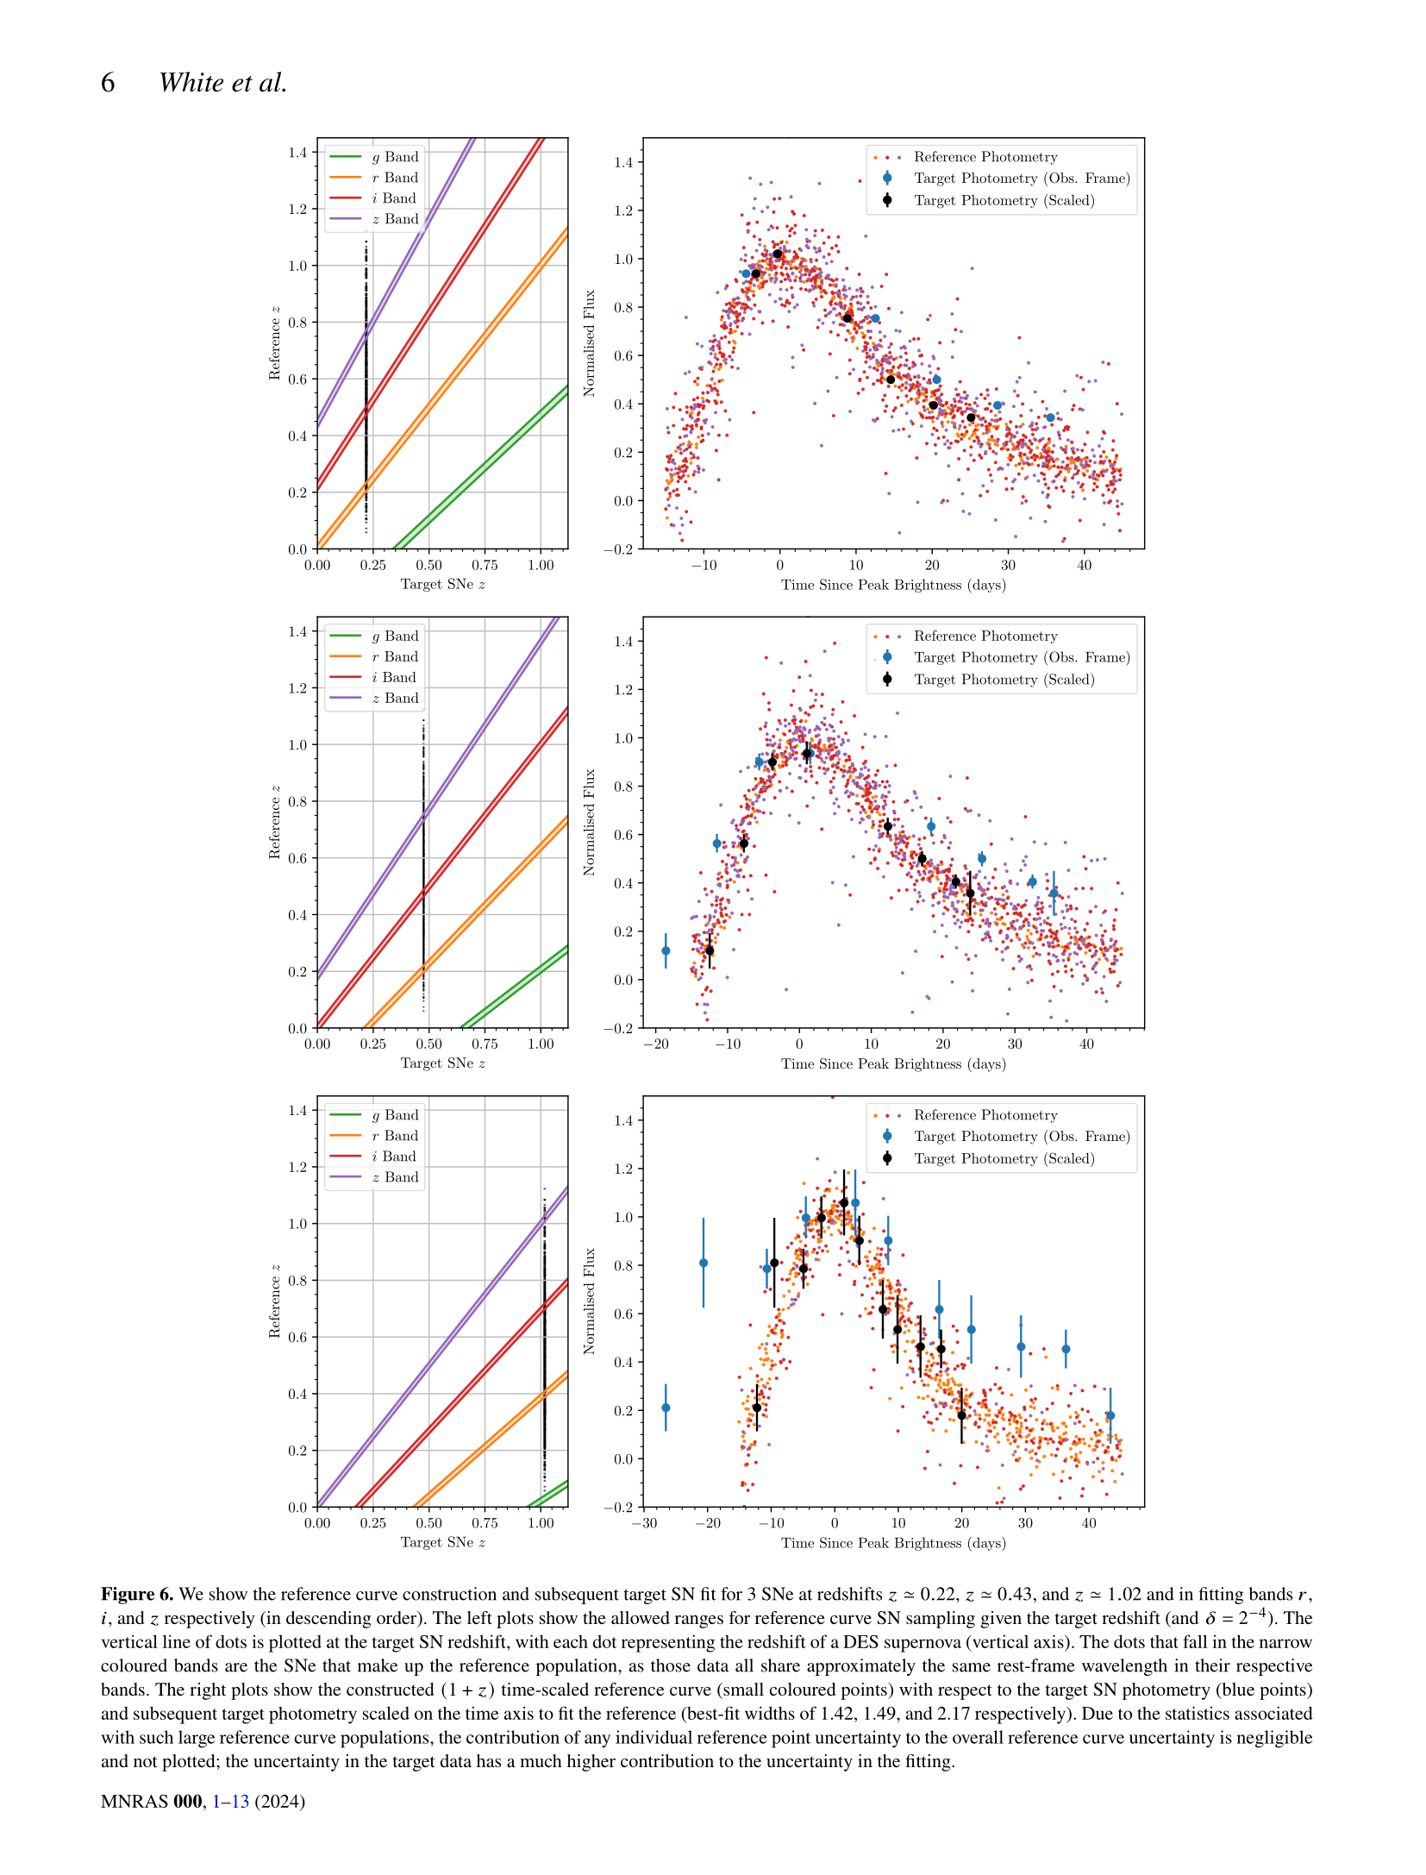





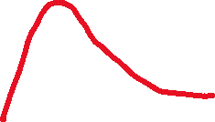

Another way that we can find time dilation is to find the ‘width’ of each individual supernova light curve.
We can make the ‘stacked’ light curve (corrected for time dilation using the result from before) and fit an individual light curve to it to find how wide it is.
Our stacked curve
The raw data for this supernova
The raw data now fit to the stacked curve
How bright the supernova is
This is what we expect the data to follow
Days since the explosion
Each black dot is an individual supernova that we have light curves for
This is how we choose what light curves go into the stacked light curve – no math needed here. Wherever the black dots intersect the coloured bands, we can take those light curves observed in that colour and put them in the stacked curve! All of these light curves should have the same shape.
All light curve redshifts
Redshift of the data we’re fitting
Here’s one of the unedited plots from the paper now that we what’s going on!

Slide 7
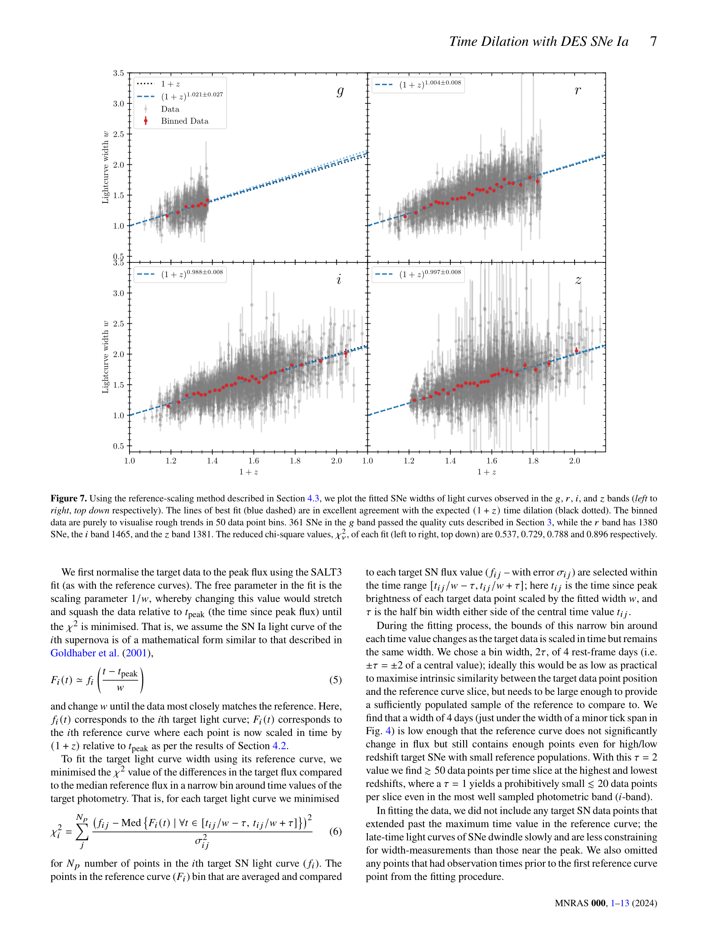
We need to check that our method works for all the Dark Energy Survey observation colours. No need to stress because this plot shows that it does!

Slide 8
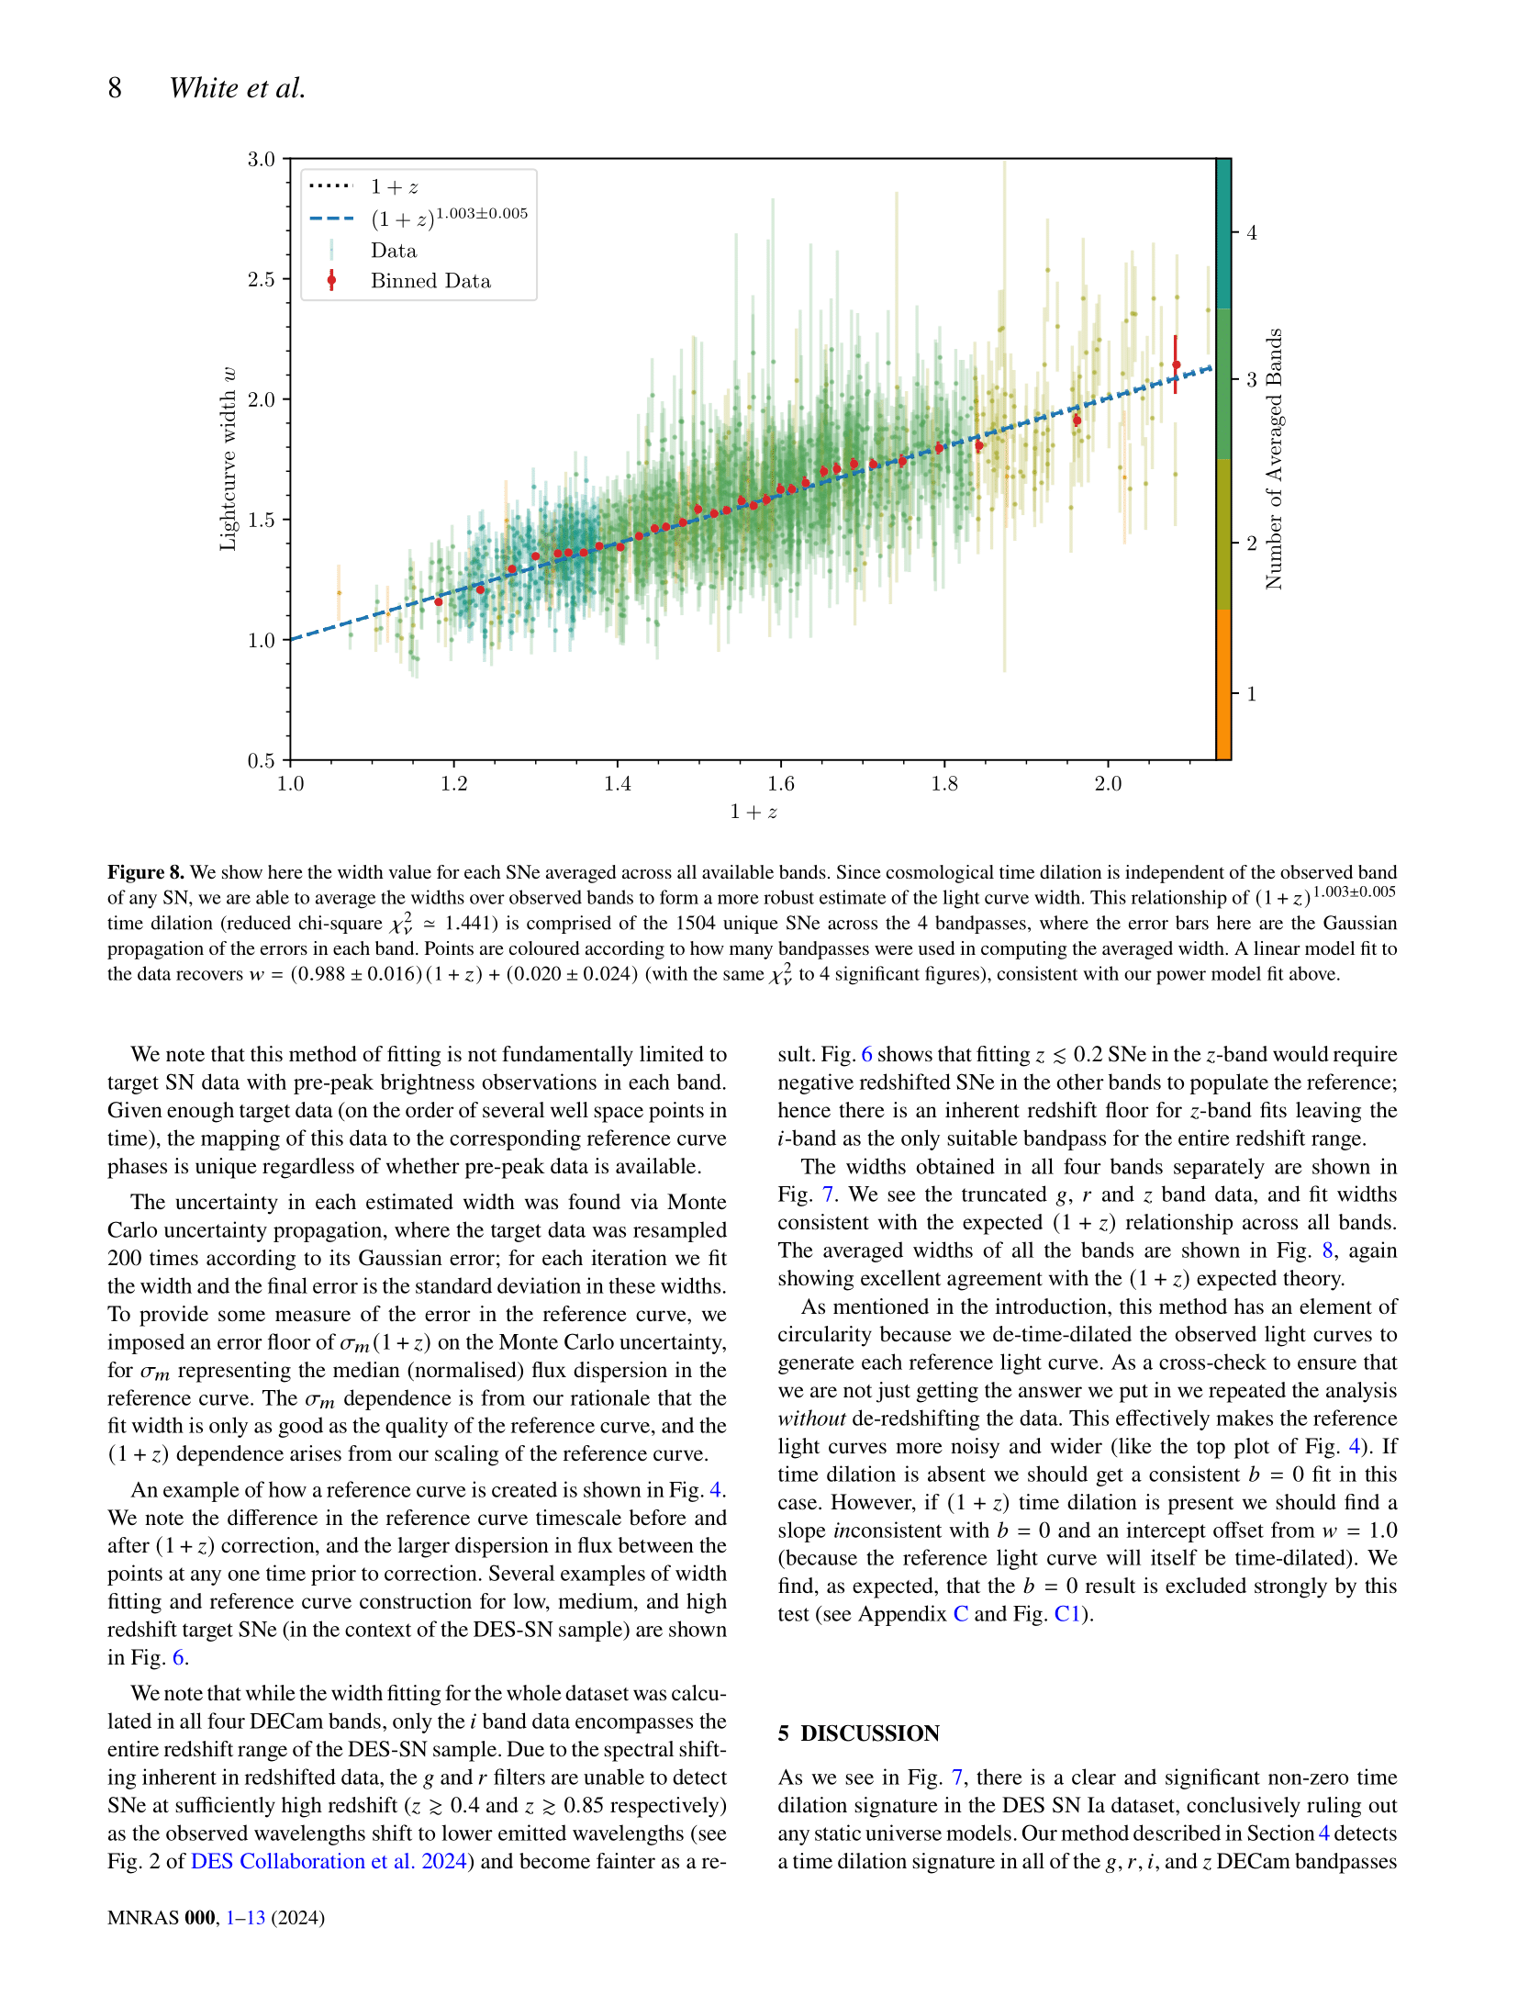

Slide 9
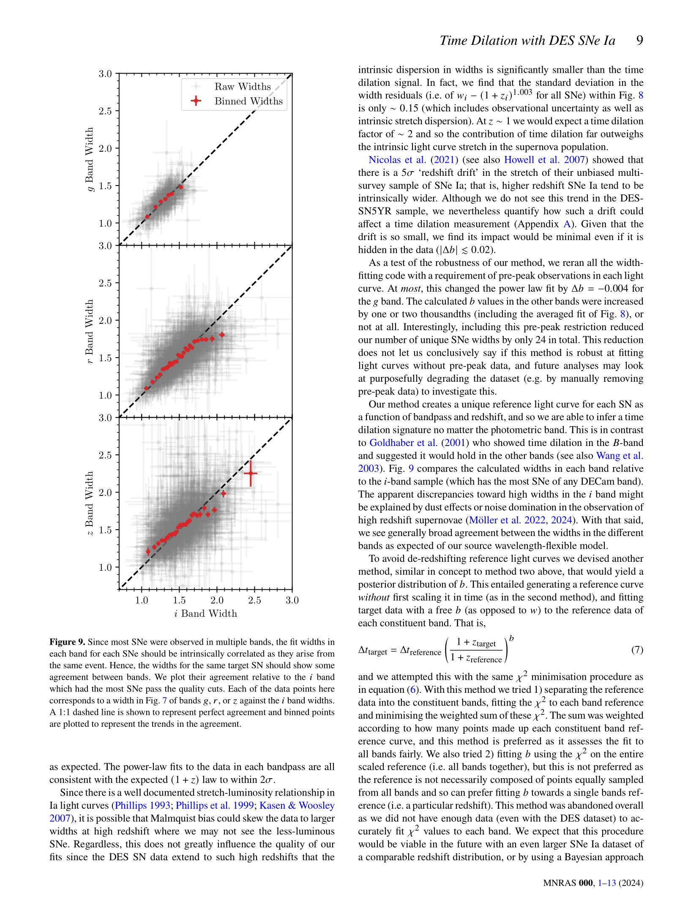

Slide 10
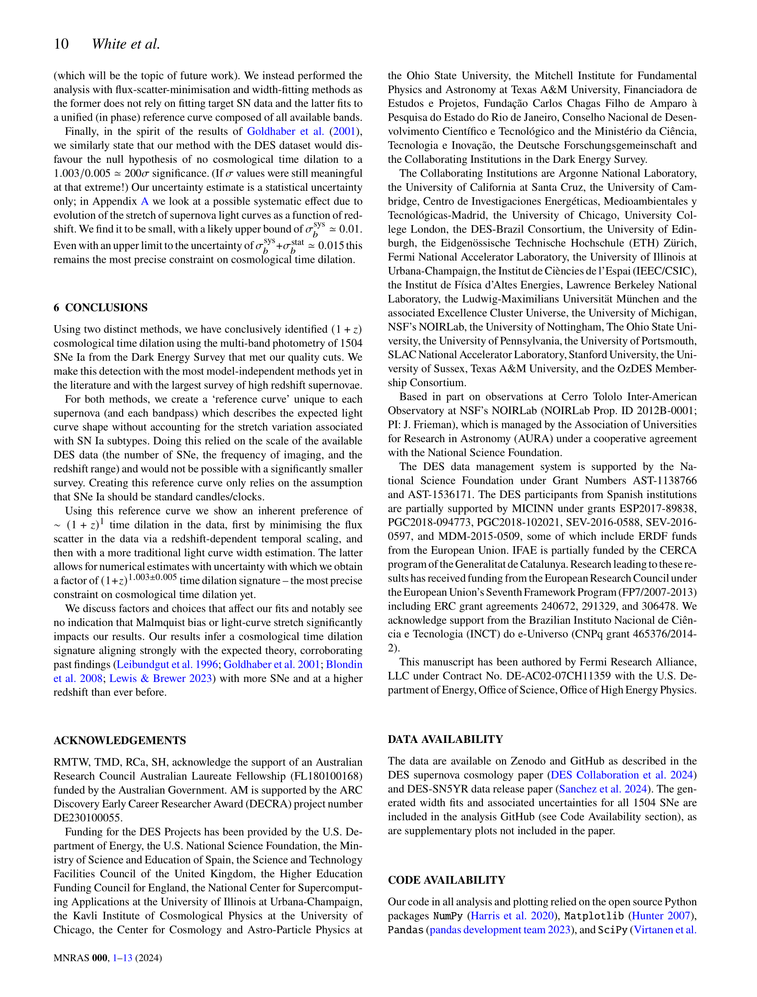

Slide 11
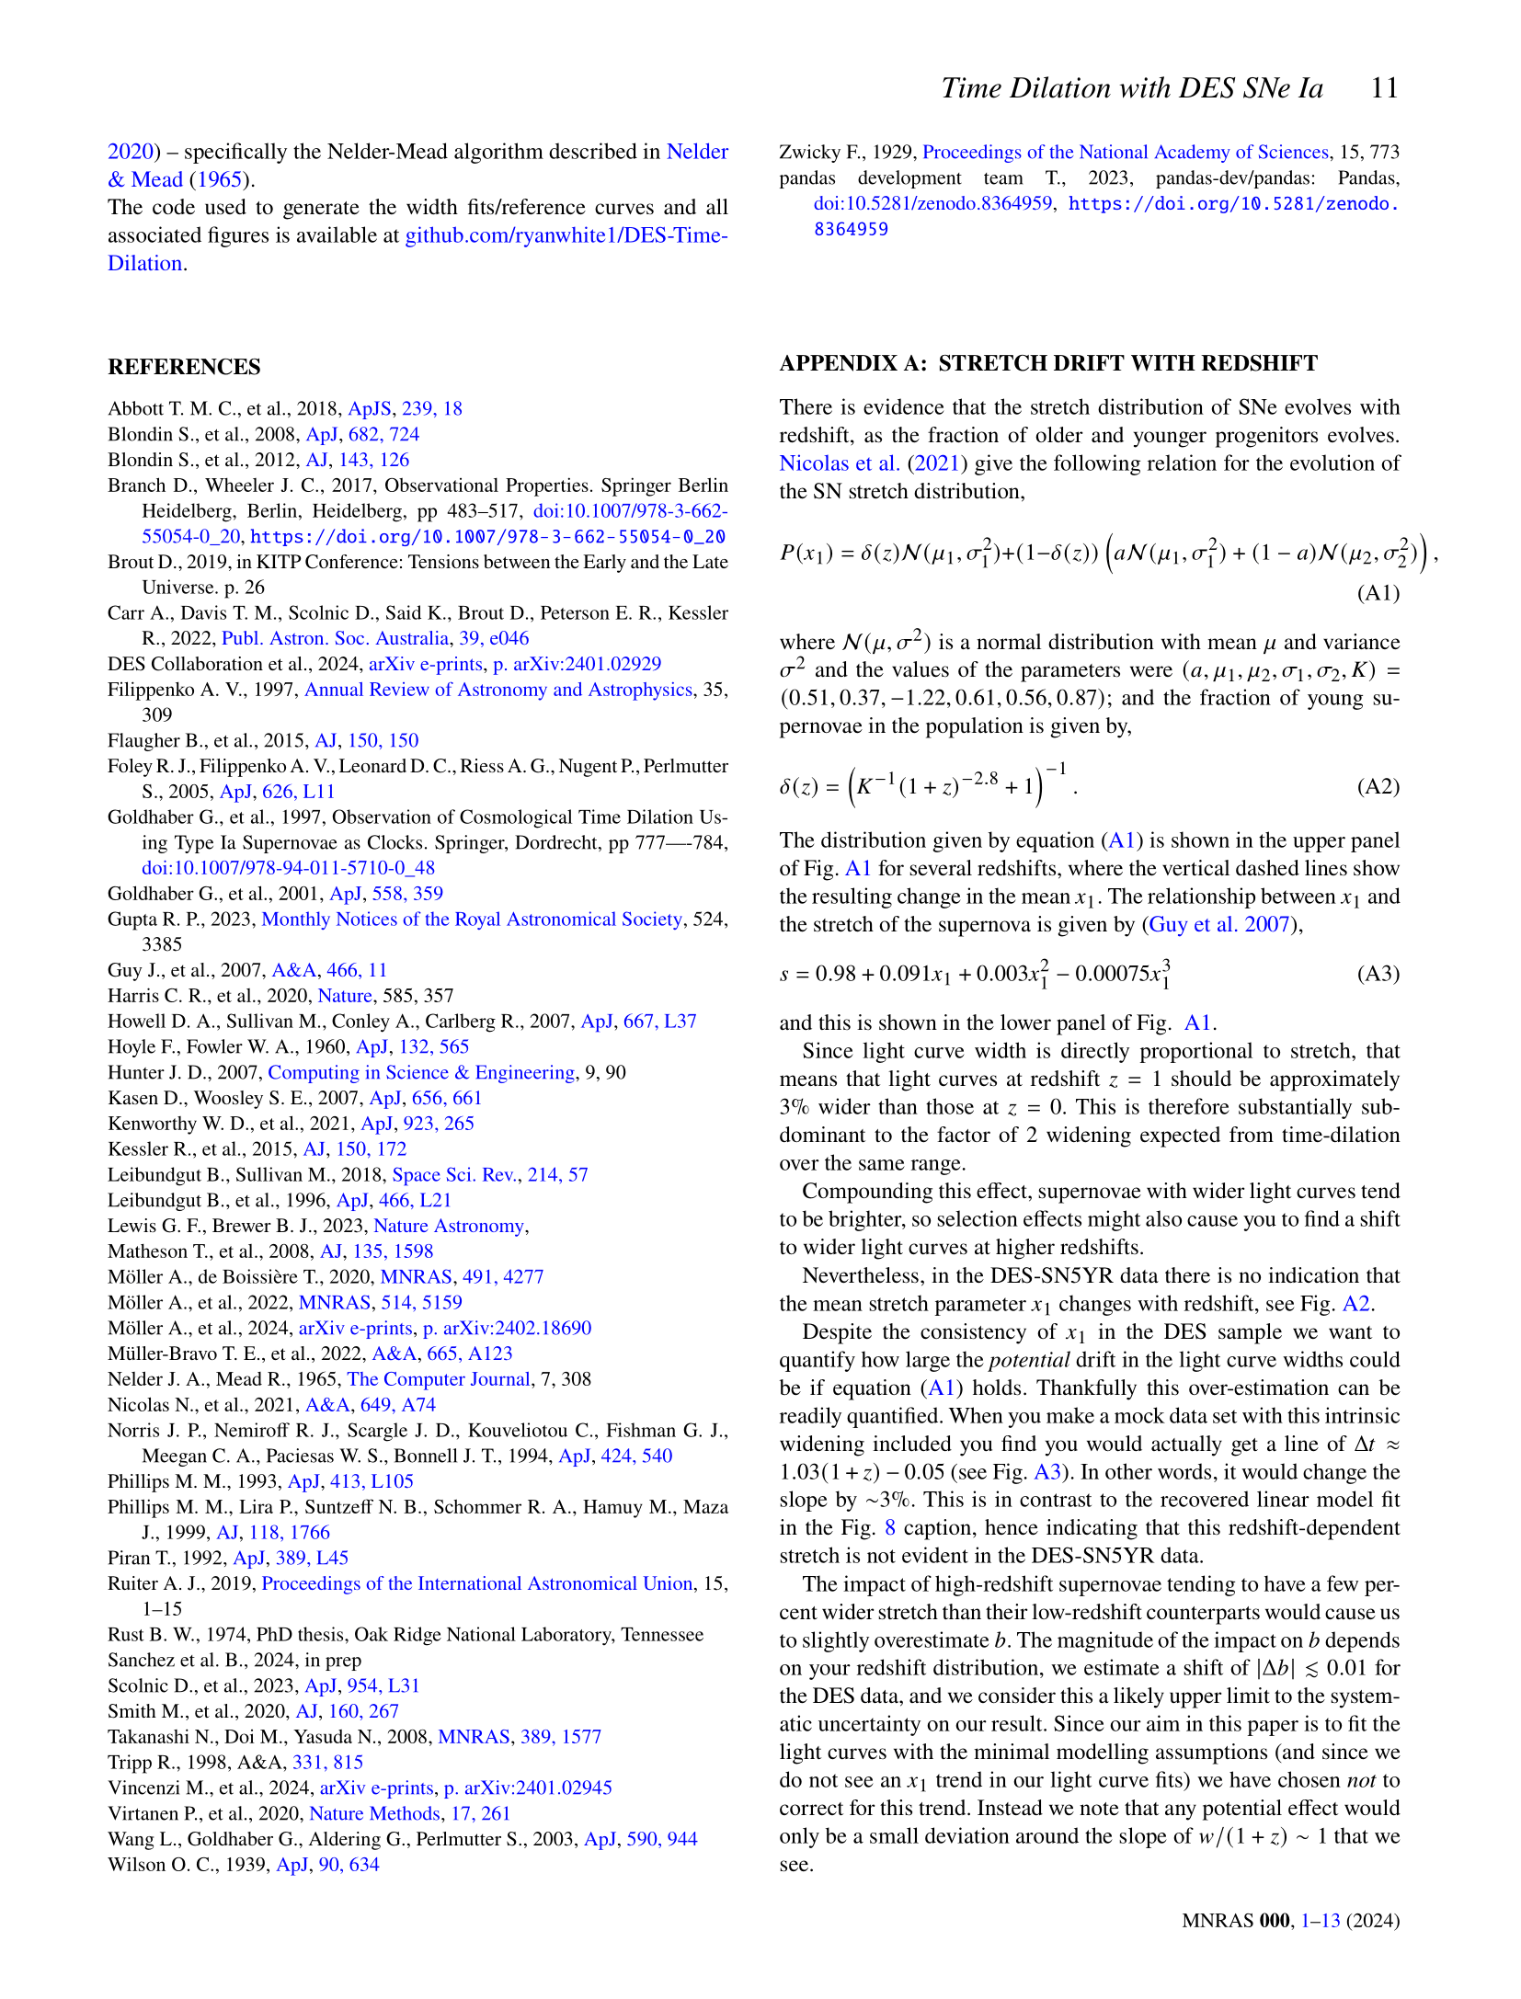

Slide 12
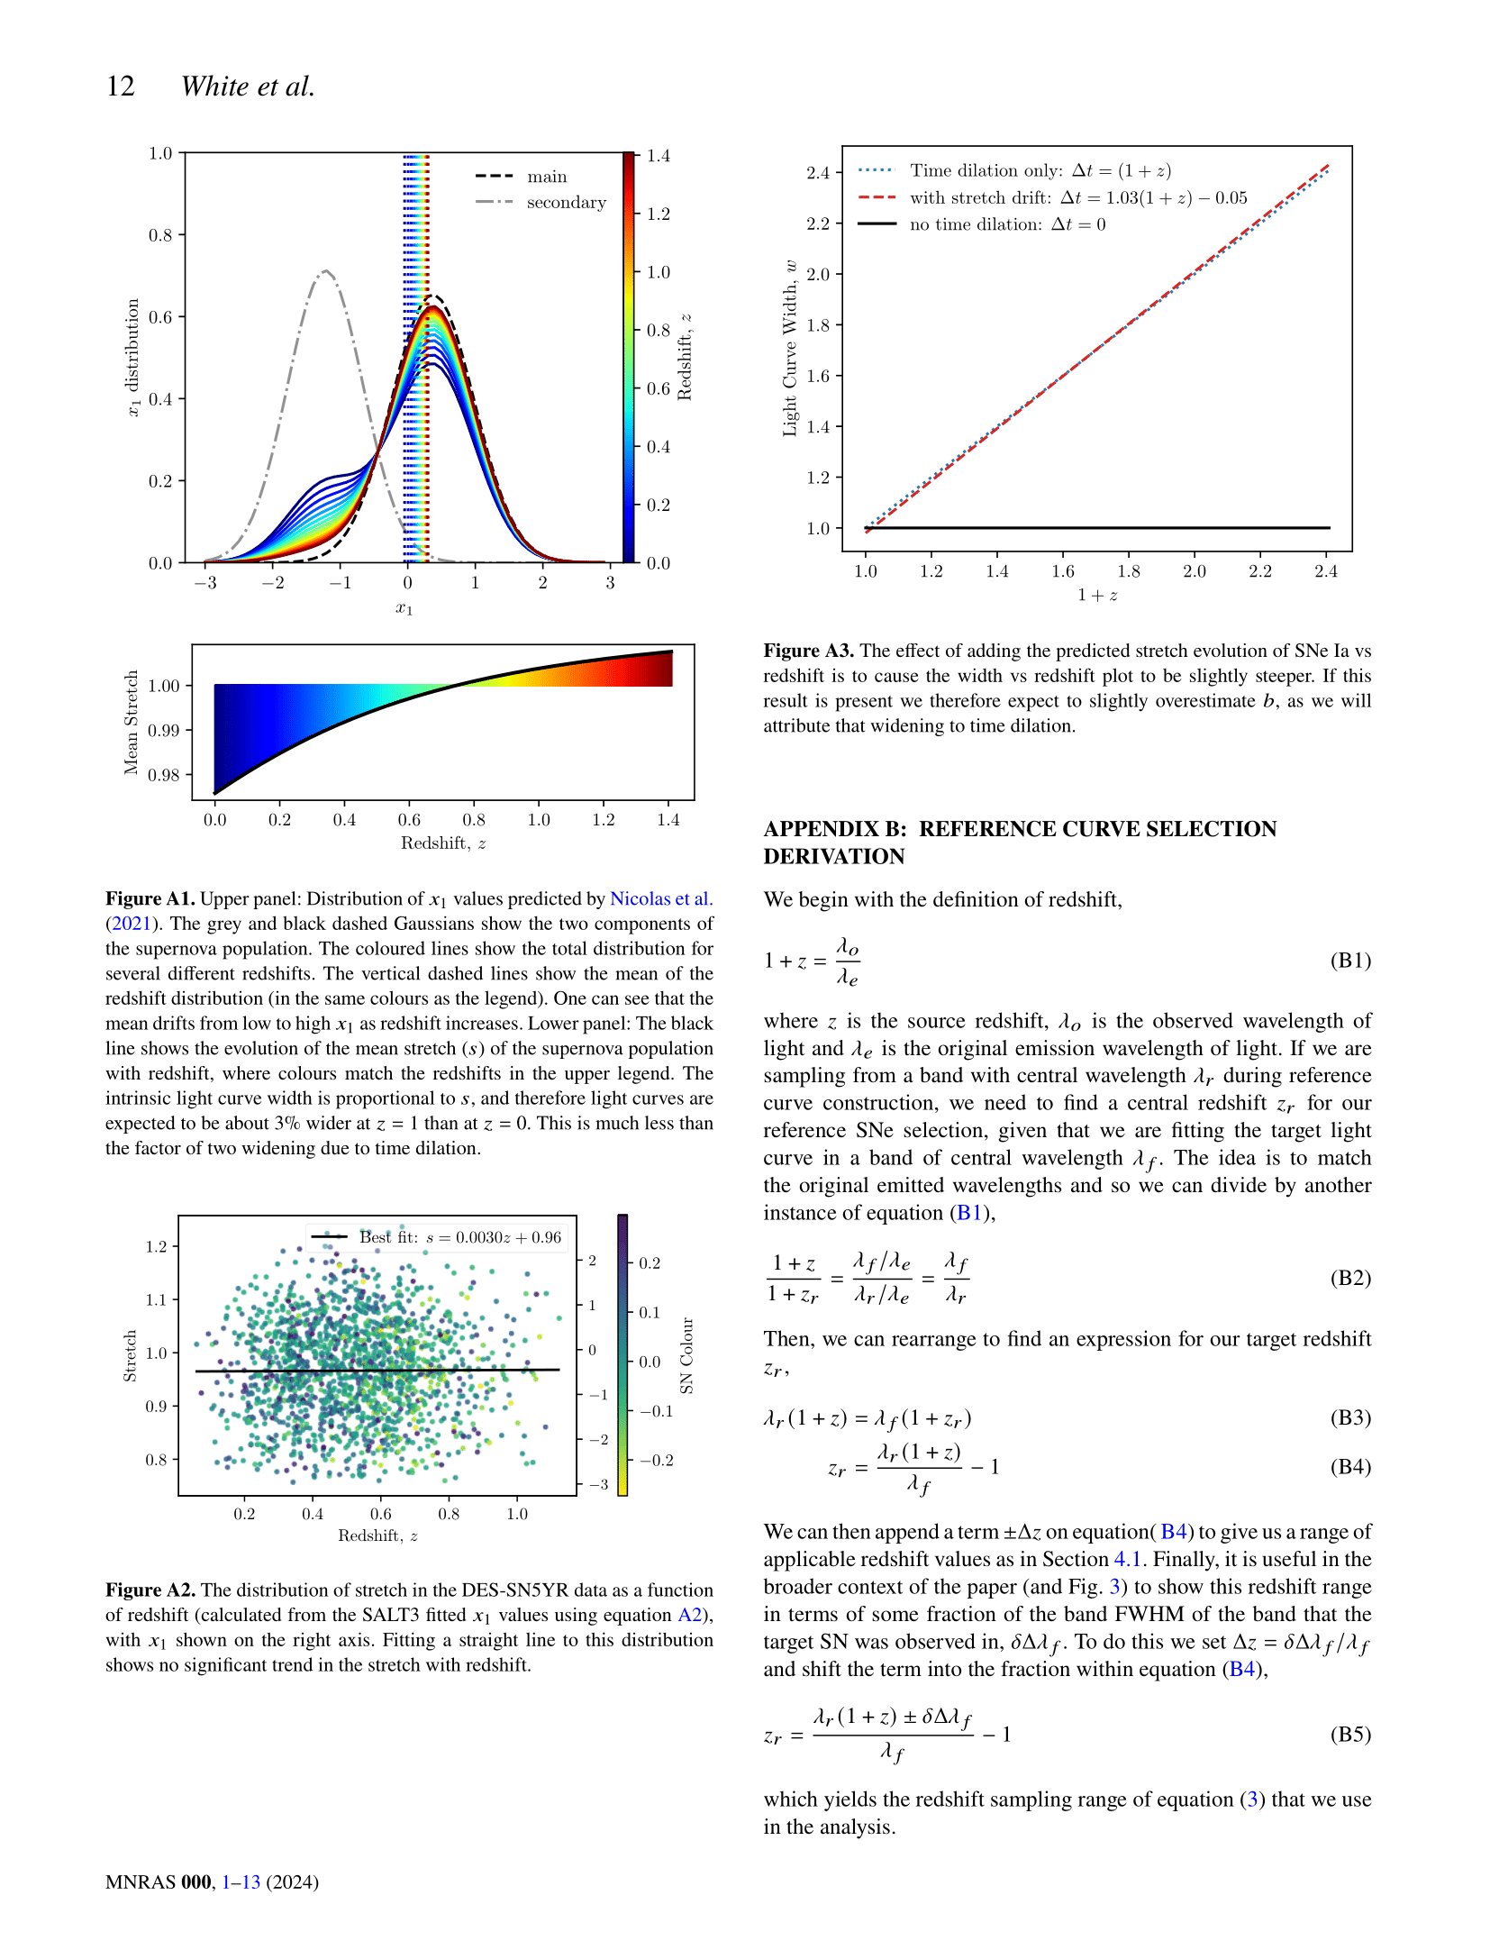

Slide 13
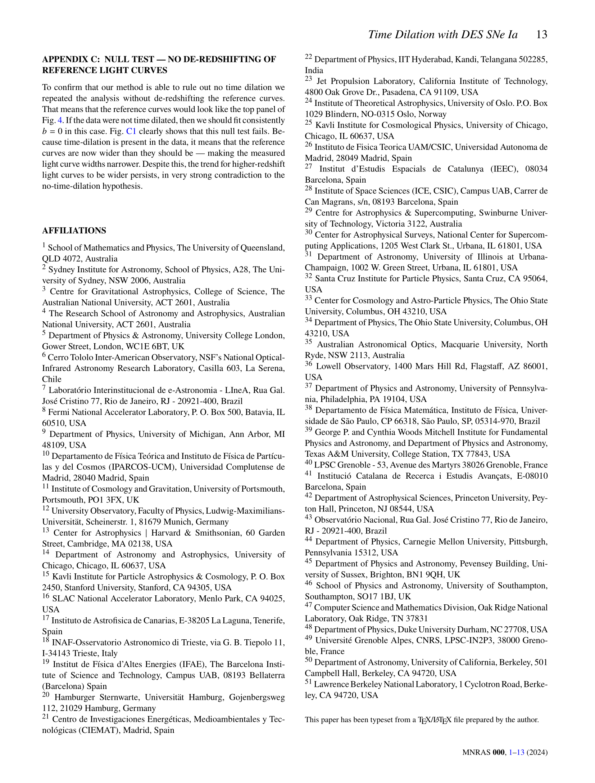

Slide 14
